Slide 1
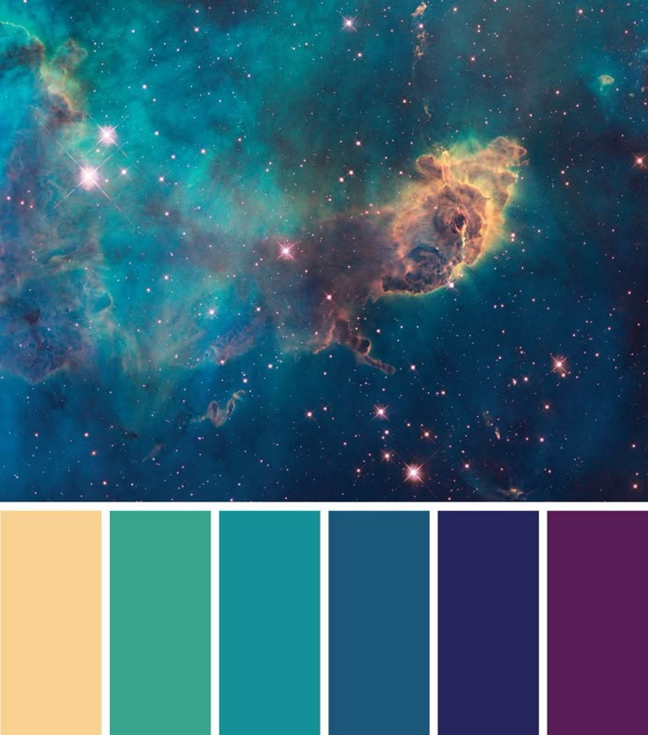
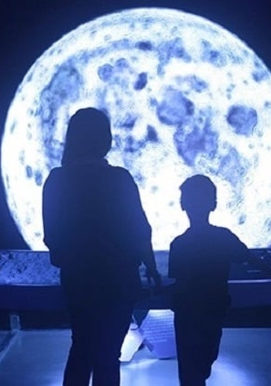
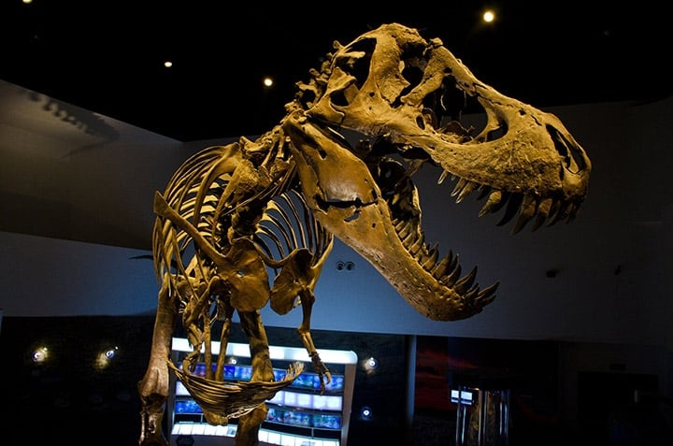
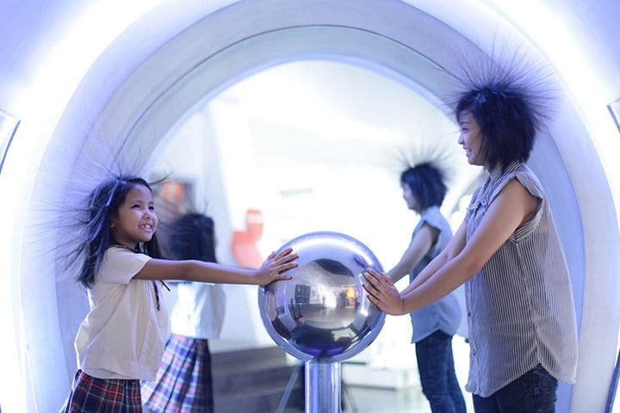
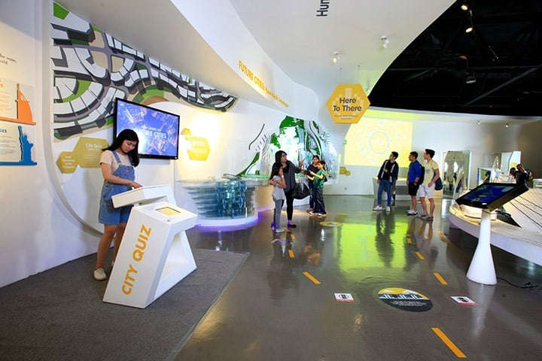
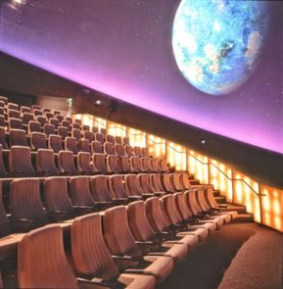
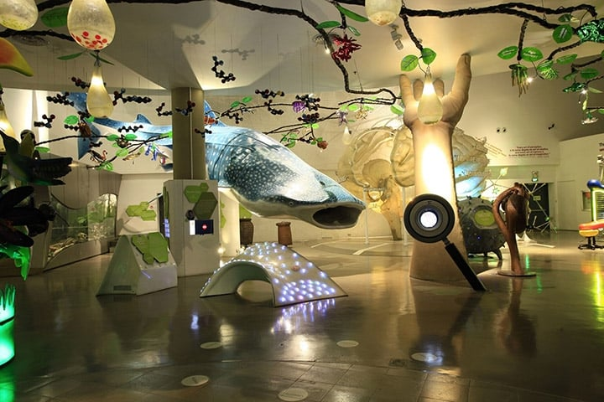
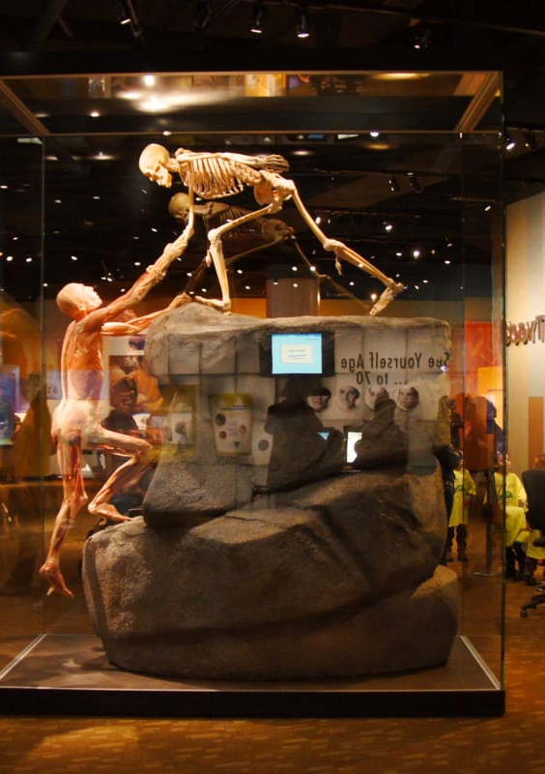
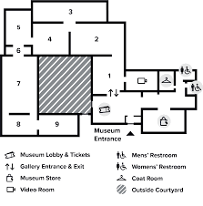
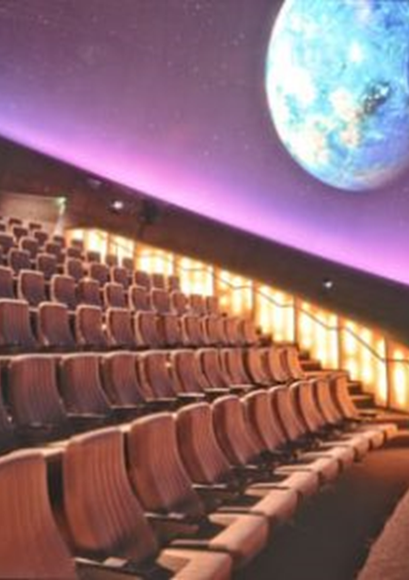
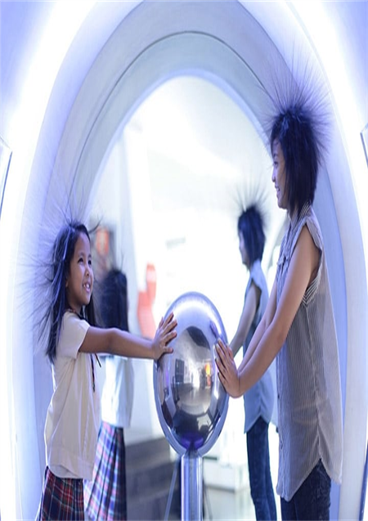
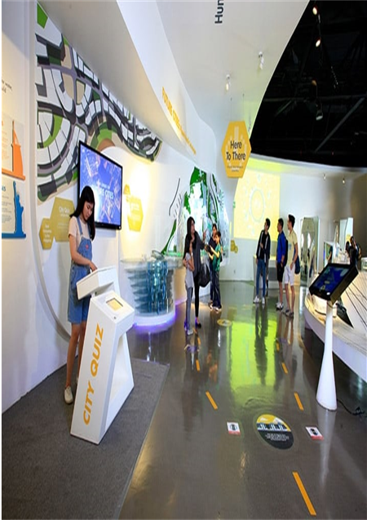

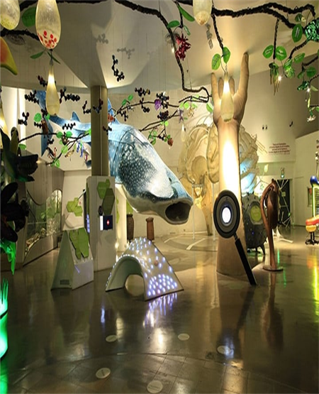
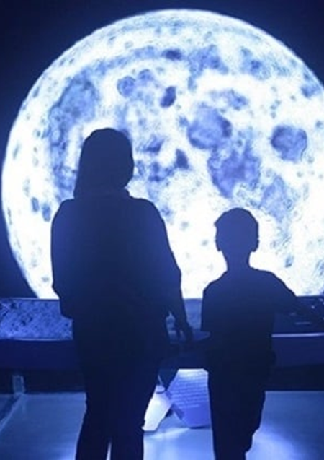
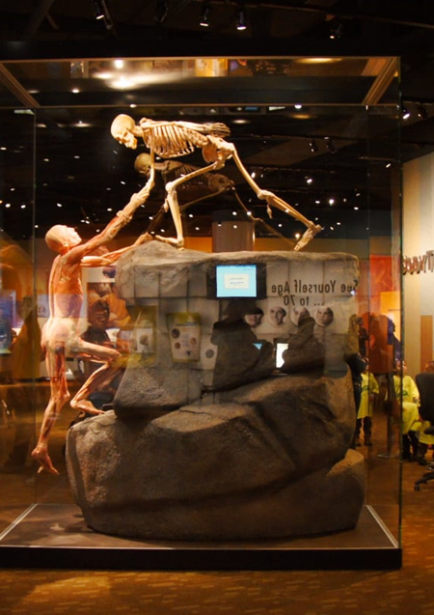

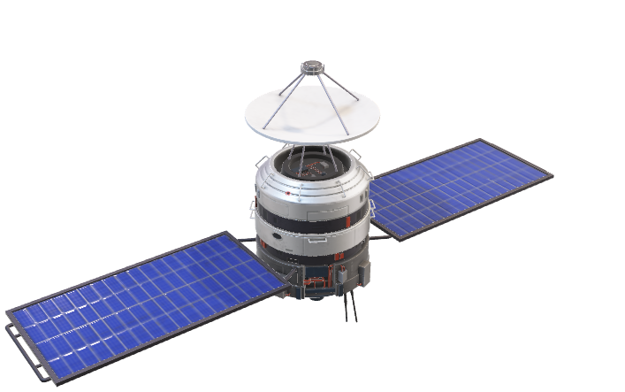
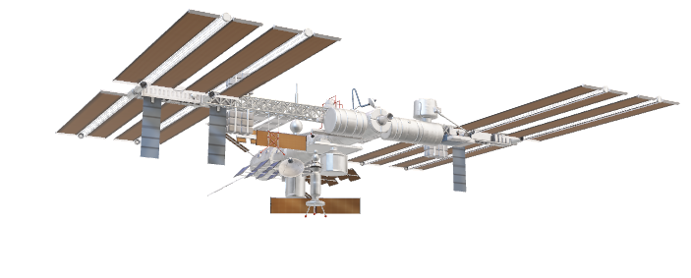
TOPICS
PLANETARIUM

Slide 2
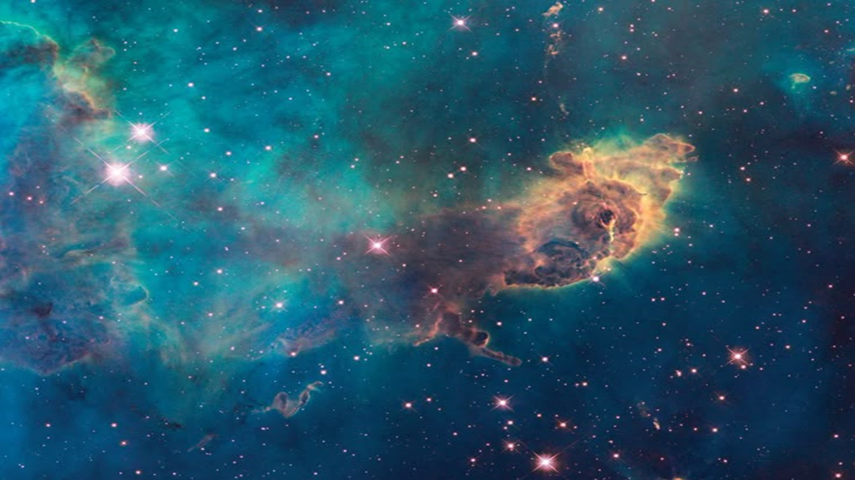
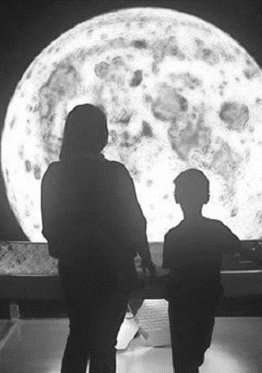
TOPICS
FOSSIL SKELETON OF A TYRANNOSAURUS REX

Slide 3
TOPICS
VAN DE GRAAFF GENERATOR

Slide 4
TOPICS
TECHNOLOGY

Slide 5
TOPICS
PLANETARIUM THEATER

Slide 6
TOPICS
Creatures of the Deep Discovery

Slide 7
TOPICS
HUMAN EVOLUTION

Slide 8
Universe Gallery: The Beginning and Majesty of the Cosmos
The Universe Gallery showcases humankind’s wondrous fascination with outer space. It features exhibits that show how all of life, as we know it, found its atomic beginnings in the stars. It enfolds visitors in the fundamental elements at play in the cosmos.

Slide 9
Earth Gallery: Nature Across the Breadth of Time
The Earth Gallery features the first permanent T. rex exhibit in the country along with other unique exhibits that focus on the forces at work in shaping and reshaping the Earth.

Slide 10
Atom Gallery: The Strange World of the Very Small
The Atom Gallery is the gallery with the most number of interactive exhibits. It contains the very elemental forces that are so familiar that we take them for granted like gravity and electromagnetism. It also presents the counterintuitive quantum world that resembles nothing in everyday experience, yet serves as the basis for much of the technology of today.

Slide 11
Technology Gallery: The Showcase of Human Ingenuity
The Technology Gallery is the largest of all the galleries. It is the only exhibition space on the second level, overlooking the other four galleries. This gallery presents technology not as a mere tool, gadget or industrial advancement but as means to flesh out human values and to help us become better humans.

Slide 12
Theater and Gates Planetarium.
There is also a gift shop, and the T-Rex Deli and Café. DMNS contains numerous hidden secrets; the museum website has printable scavenger hunts to help visitors find them.

Slide 13
Life Gallery: The Exuberant Varieties of Life
The Life Gallery showcases the exuberance of a living planet in all its forms. It features the various habitats and the astonishing number and variety of organisms that thrive on our planet.

Slide 14
A Journey Through Human Evolution
This museum exhibit uses models to depict a pivotal moment in human evolution. A hominid skeleton is shown reaching down to help a human anatomical model climb a rock formation. The scene suggests cooperation and the challenges faced by early humans. The exhibit likely explores themes of physical adaptation, environmental pressures, and the transition to bipedalism. The inclusion of a screen suggests interactive elements or additional information about the evolutionary process.

